Slide 1
Friends of Nepal-Adelaide Inc
Program Update

Slide 2
Welcome
We hope you enjoy this presentation about FONAI and our programs. This is how and where the money we raise from supporters like you is spent!
Thankyou for coming! We really appreciate your support.

Slide 3
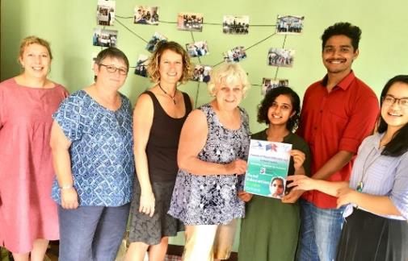
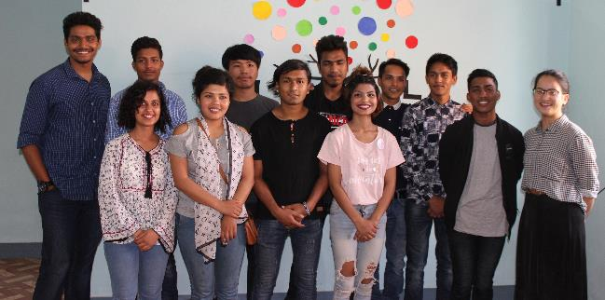
Administration
In June 2018 we partnered with Nepal NGO ‘Canopy Nepal’ to manage the scholarship program for the 2018/19 year.

Slide 4
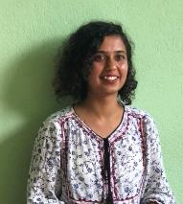
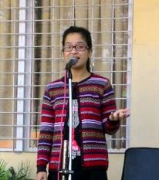
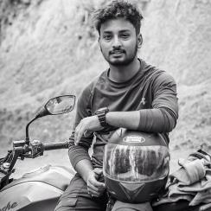
Meet the Canopy Nepal team
Mohit - Executive Director Shreya - Managing Director
Urishna - Program Director Deekshak - FES Program Manager

Slide 5
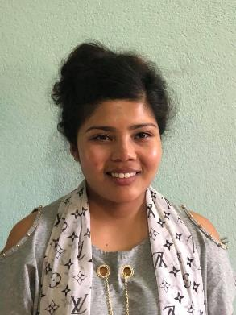
Scholarship Student - Manju
Manju 20 years second year law student Kathmandu School of Law
Board of KSL Amnesty International.
Passionate advocate for women’s rights.

Slide 6
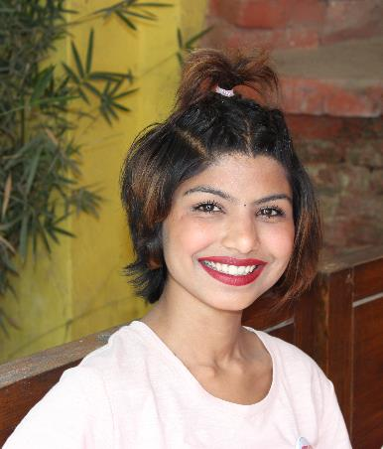
Scholarship Students
Anjana, 19 years
Final year of Diploma of Fashion Design IEC College
Joint Secretary Rotaract Club of Dilibazaar
Successfully completed 6-month internship at Didi Boutique
which she is currently managing
Planning to begin Bachelor studies in Jan 2019

Slide 7
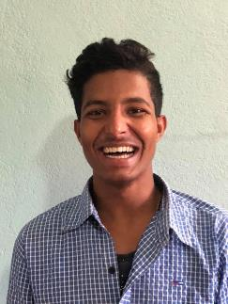
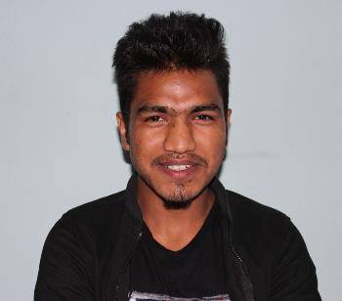
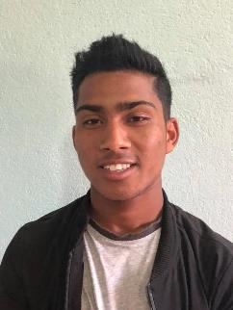
Scholarship Students – NIC College
These 3 17 year old boys have just begun their final year of secondary school.
Hem is studying science & Bijaya & Prachandra business management.
Hem Bijaya Prachandra

Slide 8
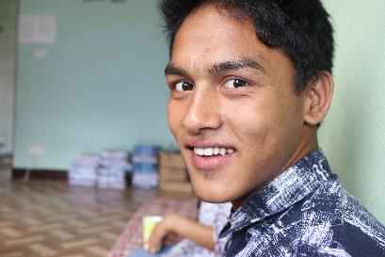
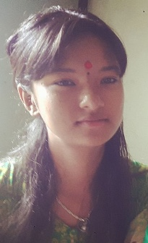
Scholarship Student SAB & Nobel College
Sushant 16 years - Year 9 loves sport & science
Shrinkhala – 17 years Year 11
Studying management at Nobel College
ge

Slide 9
Scholarship Students
Sanjeev 21 years
Currently completing final year of Bachelor in IT studies at British College
Completed 3 month internship at Spiker Solutions
Working part time teaching computers at local school

Slide 10
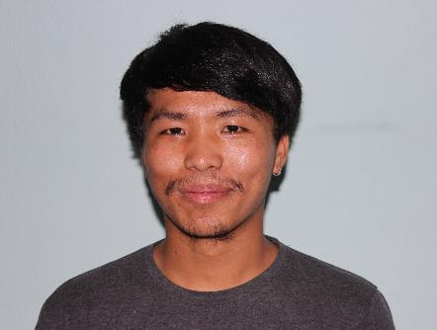
Scholarship Students
Bishal 19 years
Currently completing double degree
Just completed CAP 11 (corporate accounting) exams, awaiting results
Completing Bachelor of Business Studies - second year
Interviewing for part time job

Slide 11
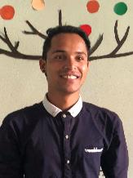
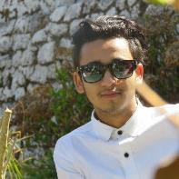
FES Graduates
Bhanu 19 years.
Currently working full time at Classic Bamboo restaurant in Thamel – ambition to be a chef
While on FONAI Scholarship Bhanu completed Year 11 & 12, a Certificate in Cookery from Sahara College of Hospitality & a 6- month internship at CFC restaurants
FONAI recently furnished a room for Bhanu where he now lives & works independently.
Sandeep 20 years
Sandeep recently completed his Year 11 & 12 at Sirjana College of Fine Arts
on full FONAI scholarship. He is currently working at a painting studio in
Thamel & living with family.
We wish both these students great success

Slide 12
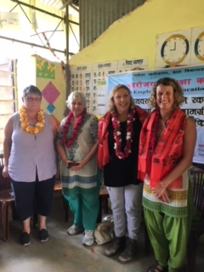
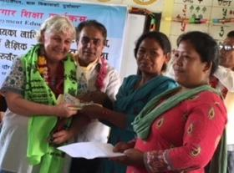
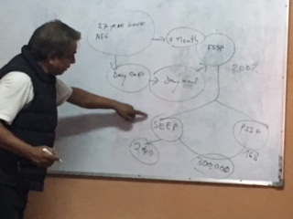
FONAI programs – Child Development Society (CDS)
FONAI has been actively involved in many programs managed by CDS over the past year!
Health camps- sponsored by Rotary Club of Blackwood
Day Care Program – private donors
SEEP program (Self Employment through Education) – private donors

Slide 13
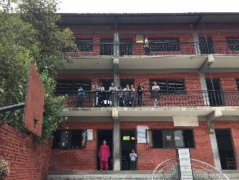
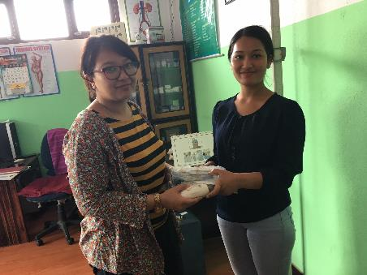
CDS Health Camps
These are regularly during year & cover many areas of high need.
They include:
General health\nutrition
Female health
Hygiene
They target local & disadvantaged communities & monitor participants over time.

Slide 14
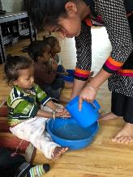
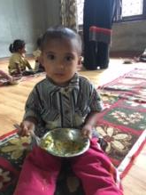
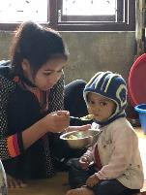
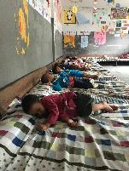
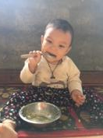
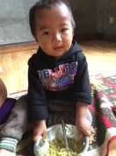
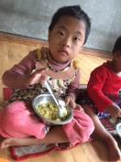
CDS – Day Care Programs
The Day care programs are held for children aged 0-5 year to allow older siblings to attend school instead of caring for younger siblings. The program also helps prevent very young children being taken to dangerous work sites & being exposed to dangerous chemicals & dust.
The parents are very poor day labourers & the program supplies health care, nutritious food & a safe environment for the children while they work. Sometimes this is the only daily meal these young children have.
FONAI is currently working with like minded groups to develop a sponsorship program which will provide long term sustainable support for this program.

Slide 15
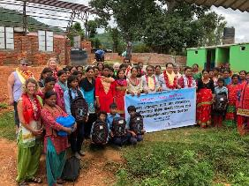
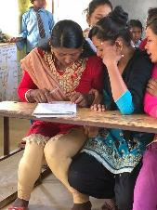
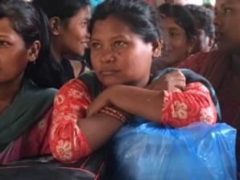
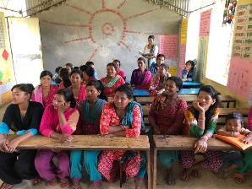
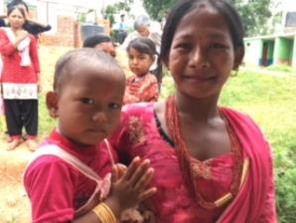
CDS- SEEP program
The SEEP program provides funding for groups of illiterate & vulnerable women to establish micro-business through literacy and basic maths training.
The aim is to reduce child poverty, labour & trafficking in rural areas. Women who have never had the chance to be educated, not only see the value of education for their children, but also have the means to keep them in school & out of brick kilns. A combination of local collaboration & self & seed money is yielding great results in at risk communities.
Finding funding for setting up more SEEP groups is also a big future focus for FONAI.

Slide 16
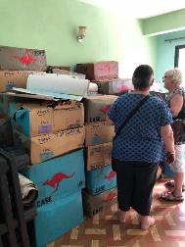
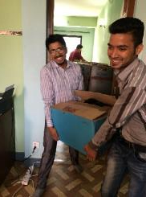
Rotary Movement and South Pacific School Aid
Over the past year we have collaborated with South Pacific School Aid, the Rotary Clubs of Blackwood, Brownhill Creek & Adelaide & the Rotaract Club of Dilibazaar to send 7 pallets of books to Nepal.
Recipients have been
Chelsea Foundation Community Library
Canopy Nepal Community library
Rotaract Club of Dilibazaar Prison Library & School Project
SAB school

Slide 17
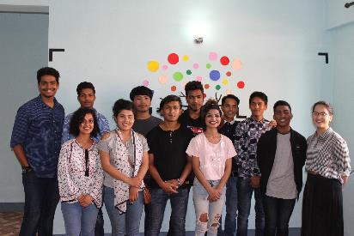
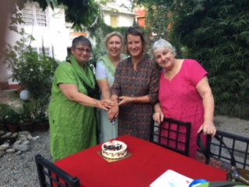
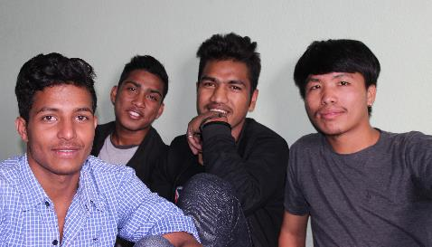
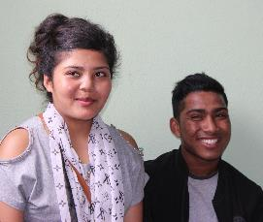
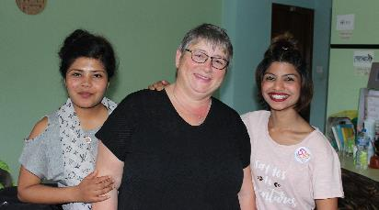
Thankyou for coming! Any Questions?

